Slide 1
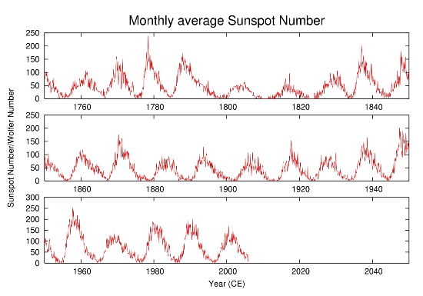
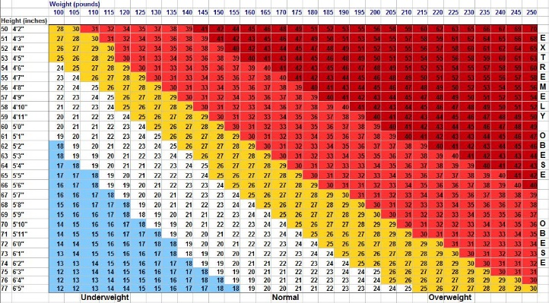
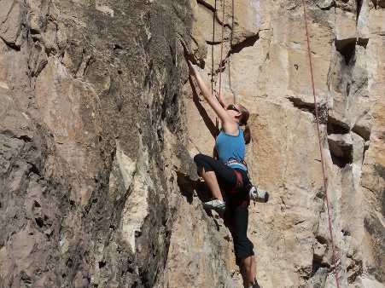
Feel free to change the color, font, layout. Please save this as a 1-page PDF and name your file according to the following convention:
Self-Intro-FamilyName.pdf
Your picture
Given Name Family Name
Grade in school (ex.MSc 2nd year, PhD 2nd year)
Department of XXXXXX, School of XXXXX, University of XXXX
About your research topic, your lab…etc.
Notable Activities, Papers and Other Achievements,
About your hometown, interests …etc.

