Slide 1
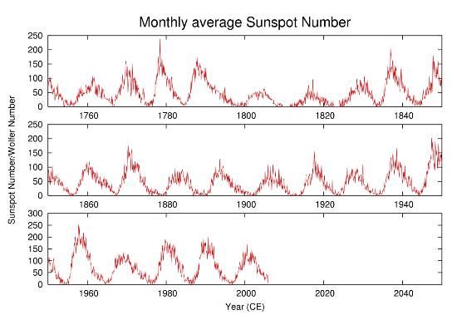
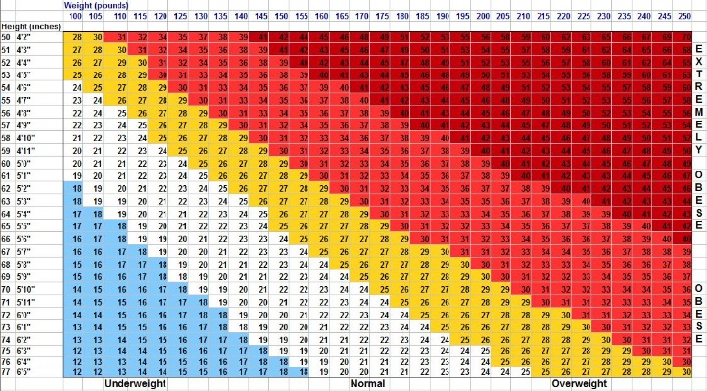
Title
Author name(s)
Department, School, University
Feel free to change the color, font, layout. Please save this as a 1-page PDF and send to the office.
About your research objective, results, ...

